Slide 1
LASER
Light Amplification by Stimulated Emission of Radiation

Slide 2
contents:-
Introduction
Stimulated absorption
Spontaneous emission
Stimulated emission
Population inversion
Einstein’s coefficient and Einstein’ relation
Characteristics of laser
Main parts of a laser
Different types of laser
Applications of laser

Slide 3
Introduction:-
The word laser is an acronym that stands for “light amplification by the stimulated emission of radiation”
Stimulated emission was postulated by Einstein in 1917.
In 1960 , a solid state ruby laser is developed by maiman.
In 1961, a gas state He-Ne laser is developed by Ali javan and others in Bell telephone laboratory.

Slide 4
Continued…….
From the theory of interaction of radiation with matter, we can get an idea regarding the working of laser.
we know that a laser beam is an intense, concentrated, monochromatic beam of light. The principle of laser is that, through artificial means(at a given time), the number of atoms in an excited state(usually referred to as the metastable state) of an element is made to be much higher than that in the ground state, resulting in the emission of a coherent, monochromatic laser as these atoms de-excite together.
The reason behind the longer lifetime of the atoms in the metastable state can be understood by Heisenberg’s uncertainity principle.
i.e. ΔE. ΔT > ћ
Consider an atom has two energy levels, E1 & E2. when it is exposed to radiation having a stream of photons, each with energy hν, three distinct processes can take place – Absorption, spontaneous emission & stimulated emission.

Slide 5




Induced absorption(stimulated absorption)
The process in which an atom sized system in lower energy state is raised in to higher energy state by absorbing EM radiation which is quanta of energy is equal to the difference of energy of the two states is called stimulated absorption.
i.e.,
hν = E₂ - E₁
E₂
E₂
E₁
E₁
Before
After

Slide 6
The probability of occurance of this absorption from state 1 to state 2 is proportional to the energy density u(ν) of the radiation.
P₁₂=B₁₂ u(ν)
where the proportionality constant B₁₂ is known as the Einstein’s coefficient of absorption of radiation.

Slide 7
Spontaneous emission:-
If an atom is initially in the upper state E₂, it can come down to lower state E₁ by emitting a photon of energy hν. This is known as spontaneous emission. This is the natural radiation decay process.
Before After emission
E₂
hν
E₁
Atom in excited state
Atom in ground state

Slide 8
The probability of occurance of this spontaneous emission transition from state 2 to state 1 depends only on the properties of state 2 and 1 and is given by
P’₂₁=A₂₁
where A₂₁ is known as the Einstein’s coefficient of spontaneous emission of radiation.
Einstein was the first to point out a third possibility of induced emission in which an incident photon of energy hν causes a transition from upper energy state E₂ to lower energy state E₁.

Slide 9
Stimulated emission:-
According to Einstein, an atom in the excited energy state may, under the influence of the EM field of a photon of frequency ν incident upon, it jumps to lower energy state emitting an additional photon of same frequency (ν).Hence two photons , one original and the other emitted, move together.
Before After
Excited state
E₂
E₁
Ground state
i.e.
E₂ – E₁ = h ν

Slide 10
Continued…….
The direction of propagation, phase, energy and state of polarization of the emitted photon is exactly same as that of incident stimulating photon so the result is an enhanced beam of coherent light.
The probability of occurance of stimulated emission transition from upper energy state E₂ to lower energy state E₁ is proportion to the energy density u(ν) of the radiation & is expressed as
P”₂₁=B₂₁ u(ν)
Where B₂₁ is the Einstein’s coefficient of stimulated emission of radiation.

Slide 11
Continued……
Thus, total probability of emission transition from the upper level 2 to lower level 1 is given by
P₂₁ = P’₂₁+ P”₂₁
Or
P₂₁ = A₂₁ + B₂₁ u(ν)

Slide 12
Population inversion:-
In a system of atoms in thermal equilibrium hν =E₂ - E₁, the no. of atoms in the ground state is generally much greater than in a higher energy state. This is known as normal population inversion of atoms among the available energy states.
A state in which the no. of atoms in higher energy state is greater than that of lower energy state is known as population inversion.
The concept is of fundamental importance in laser science because the production of a population inversion is a necessary step in the workings of a laser.

Slide 13
Einstein's coefficient and Einstein's relation:-
Let N₁ & N₂ be the no. of atoms at any instant in the state 1 and 2 respectively. The probability of absorption transition for no. of atoms from state 1 to 2 per unit time is given by
N₁P₁₂=N₁B₁₂ u(ν) ………………(1)
The total probability of transition for no. of atoms from state 2 to 1 ,either by spontaneously or by stimulated emission per unit time is given by
N₂P₂₁ = N₂ [A₂₁+B₂₁ u(ν)]………….(2)

Slide 14
In thermal equilibrium at temp. T , the absorption and emission probabilities are equal and thus we can write
N₁P₁₂ = N₂P₂₁
N₁B₁₂ u(ν) = N₂[A₂₁ + B₂₁u(ν)]
u(ν)=N₂A₂₁/N₁B₁₂-N₂B₂₁
u(ν) =A₂₁/B₂₁[(N₁/N₂)(B₁₂/B₂₁) - 1]
But acc. to Einstein, B₁₂ = B₂₁
hence , u(ν)=A21/B21(N1/N2 - 1)

Slide 15
Acc. To Boltzmann’s law the distribution of atoms among the energy states E₁ and E₂ at the thermal equilibrium at temp. T is given by
or
Here k is the Boltzmann constant. So,

Slide 16
Planks radiation formula yields the energy density of radiation u(v) as
Comparing these equations we get
(5)
This shows the relation between the Einstein’s coefficients A₂₁ & B₂₁ which also shows the probabilities of spontaneous & stimulated emissions.
i.e. acco. to eqn (5), ratio of Einstein’s coefficients is proportional to cube of frequency which means probability of spontaneous emission increases rapidly with the energy diff. between the two states.

Slide 17
Principle of laser:-
Let us consider an assembly of atoms of some kind that have metastable states of excitation energy hν.
The important requirement to achieve the laser action is that there should be more atoms in the meta stable state than in the ground state.
If this condition is achieved, there will be more stimulated emissions from atoms in the metastable state than induced absorptions by atoms in the ground state.
The step by step process that takes place in laser action are:-

Slide 18
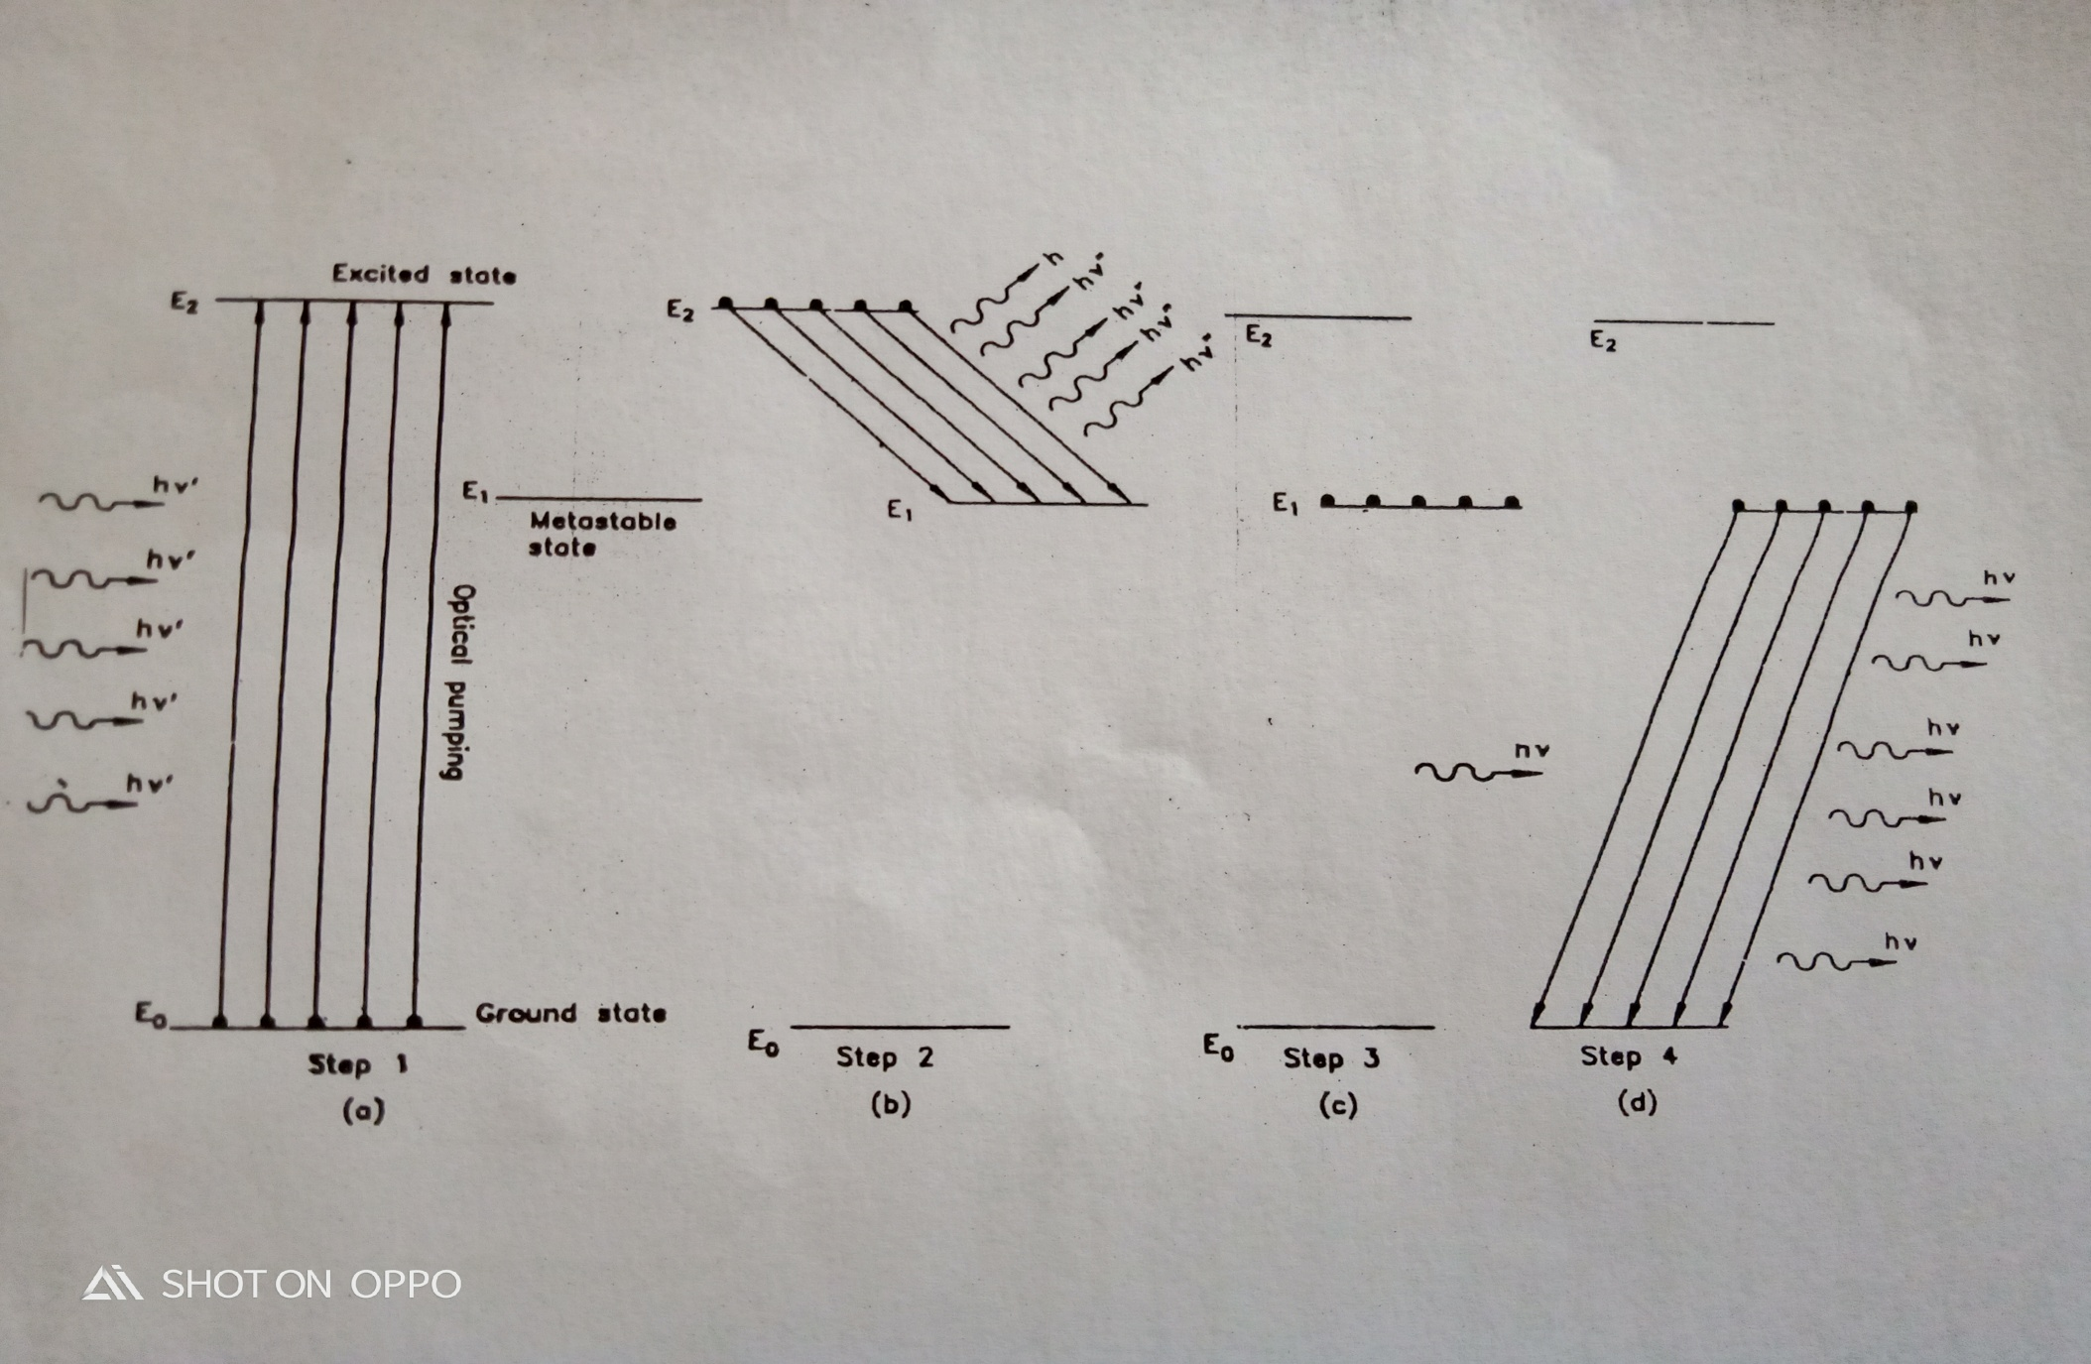
The step by step process that takes place in laser action are:-
Step-1:- Atoms in the ground state are pumped to state E₂ by photons of energy hν’=E₂-E₀ ,where ν’ is the frequency of incident radiation and E₂,E₀ are the energy of excited state and ground state respectively.(fig.a)

Slide 19
Step-2:- Rapid transition to metastable state E₁ by spontaneous emission of photons of energy hν’’=E₂-E₁, where ν’’ is the frequency of emitted radiation and E₁ is the energy of meta stable state(fig. b). This is non radiative transition.
These transitions follow hund’s rule.

Slide 20
Step-3:- By this way more number of atoms are in metastable states.(fig.c) & fulfills the condition of population inversion.

Slide 21
Step-4:- when photons of energy hν=E₁-E₀ are incident with the secondary photons themselves stimulating further transitions to produce an avalanche of coherent beam(fig.d) . This is known as induced emission.

Slide 22
Continued…..

Slide 23
Characteristics of laser:-
It is highly coherent.
It is monochromatic in nature.
Laser beam is collimated i.e hardly divergent.
Highly intense.
Highly directional.

Slide 24
Main parts of a laser:-
Active medium or working substance
Pumping source or energy source
Resonant cavity/optical resonator

Slide 25

Active medium or working substance:-
This is the basic material in which atomic and molecular transitions take place leading to laser action.
It is the medium where the stimulated emission take place.
Depending on the active medium lasers are classified into different types like solid, gas, dye or liquid, semiconductor laser.

Slide 26
Pumping:-
The process of achieving population inversion is known as pumping of atom. Most commonly used methods are as follows:-
Optical pumping(used in ruby laser)
Electric discharge (used in He-Ne laser)
Inelastic atom atom collision.
Direct conversion ( used in semiconductor laser)
Chemical reaction(used in CO2 Laser)

Slide 27
Three level pumping:-
E₁ level is the ground state, E₂ and E₃ are both excited state. The pumping process excites the atom to go to level E₃ directly from E₁
E₃ - E₁ = hν_{p}
Where ν_{p} is the pumping frequency.
E₃
E₂
hν₂₁ = E₂ - E₁
E₁

Slide 28
Continued…
But E₃ state is not a stable state and atoms undergo downward transition to E₂ or E₁.The transition E₃ -> E₁ is spontaneous. The probability of this transition is comparable to E₃ -> E₂.
E₂ is a metastable state. At E₂ , the spontaneous probability for E₂ -> E₁ transition is much less if the medium is exposed to frequency ν_{p.} The result is, the large accumulation of atoms at E₂ level, hence population inversion is achieved.

Slide 29
Now if an energy photon ν₂₁ is used for triggering the transition E₂-E₁ following the equation hv₂₁ = E₂-E₁ to produce stimulated emission of photon of energy hv₂₁.

Slide 30
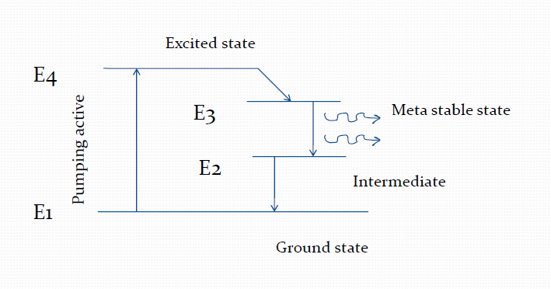
Four level pumping:-

Slide 31
The active centers are pumped from ground level E₁ to the uppermost level E₄ from where they readily fall to intermediate level E₃ i.e metastable state, keeping level 2 empty.
Now level 3 is populated inversely w.r.t level 2. If a triggering incident beam has frequency v₃₂ , the stimulated transition E₃ to E₂ is possible in chain.
The atoms from E₂ to E₁ may go spontaneously with non radiative transition.

Slide 32
Resonant cavity:-
It is specially designed cylindrical tube
Set of mirrors at the ends of which are silvered one and being completely silvered at which the other is partially silvered
Photons are emitted parallel to the axis of the active medium which undergo multiple reflections between them
So, the light intensity can be increased.
Energy source
Working substance
Partially
silvered
Fully silvered

Slide 33
Types of laser:-
Solid state laser ex.-Ruby laser
Gas laser ex.-He-Ne laser
Liquid laser
Semiconductor laser

Slide 34
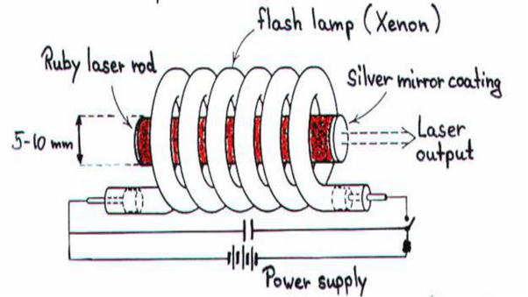
Ruby laser:-

Slide 35
Construction:-
In ruby laser a cylindrical ruby rod made up of aluminum oxide which is doped with 0.05% weight of chromium oxide.
One end of rod is fully silvered and the other one partially silvered so it act as optical resonator.
The rod is surrounded by a glass tube which in turn is surrounded by the helical flash lamp filled with xenon gas.

Slide 36
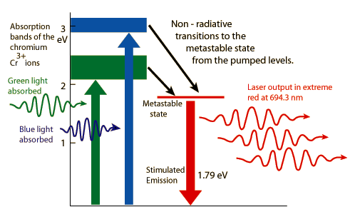
Working:-
When the flash lamp light will be flashed on ruby rod the chromium ions excited to higher energy states.
After staying for up to 10⁻⁸ second ions get transmitted to the metastable state.
The laser radiation of a wavelength of 6943A⁰ and laser emission is pulsed one.

Slide 37
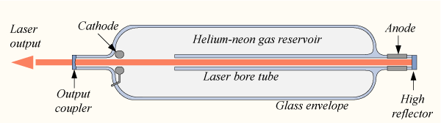
He-Ne Laser:-

Slide 38
Construction:-
A He-Ne laser consists of large and narrow discharge tube filled with helium a and neon gases in the ratio 10:1.
The tube is enclosed between fully and partially reflective mirrors which serve as optical cavity.
The two end windows are set at Brewster's angle, so reflected radiations enter into the tube become polarized.

Slide 39
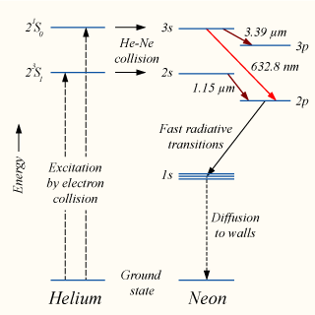
Working:-
Helium atoms after transferring their energies to neon atoms are excited to 2s and 3s.
The population in theses levels is more than those in lower levels 2p and 3p.
The emission of radiation having wavelength 6328A⁰ is red in colour and it gives continuous emission of radiation.

Slide 40
Semiconductor laser:-
In these lasers, junction diodes are used.
The doping of p-n junction diode is done.
Both the acceptors and donors are doped. These are known as ILD(Injection Laser Diodes).
Whenever the current is passed then the light modulation from the ILD can be seen. This is used in various electronic equipments

Slide 41
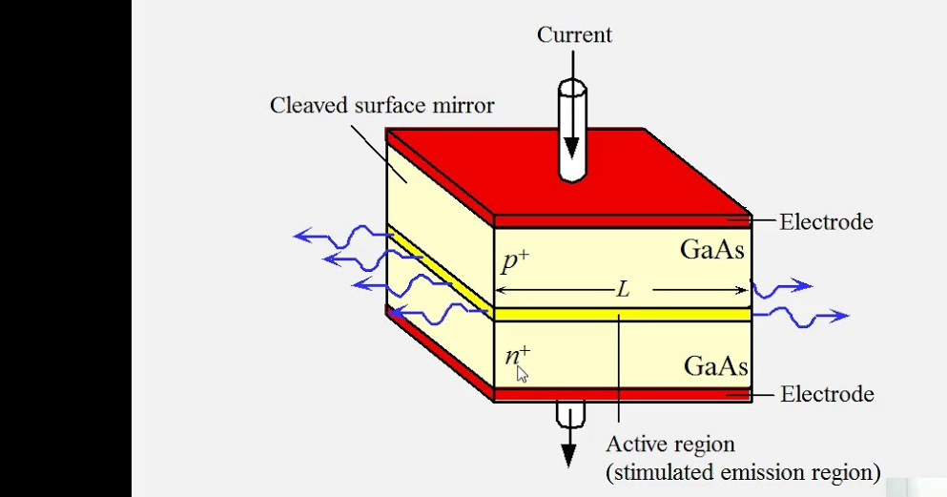
DIAGRAM:-

Slide 42
Applications:-
Modulated laser beam have been used for communication.
Lasers are used in medical field.
High power laser have been used for cutting & drilling holes in hard metal and diamonds.
They have been used in the production and research with holograms, they are also used in high speed photography and fiber optics.
Lasers are used in photodiode detection.
Laser are used in printers.
Lasers are used as barcode scanners in library and in supermarkets.

Slide 43
Holography:-
Holography was invented by Denis Gabor in 1947.
Holography is a technique that allows the light scattered from an object to be recorded and later reconstructed so that it appears as if the object is in the same position relative to the recording medium as it was when recorded.
The image changes as the position and orientation of the viewing system changes in exactly the same way as if the object were still present thus making the recorded image appear 3 dimensional.

Slide 44
In holography the light waves reflected from an object are recorded. This photographic record is called a hologram.
The hologram has no resemblance with the object, although it contains all information about the object in a kind of optical mode.
When it is illuminated by a coherent light source, a 3 dimensional image of the original object is formed.
The formation of image from hologram is known as the reconstruction process.

Slide 45
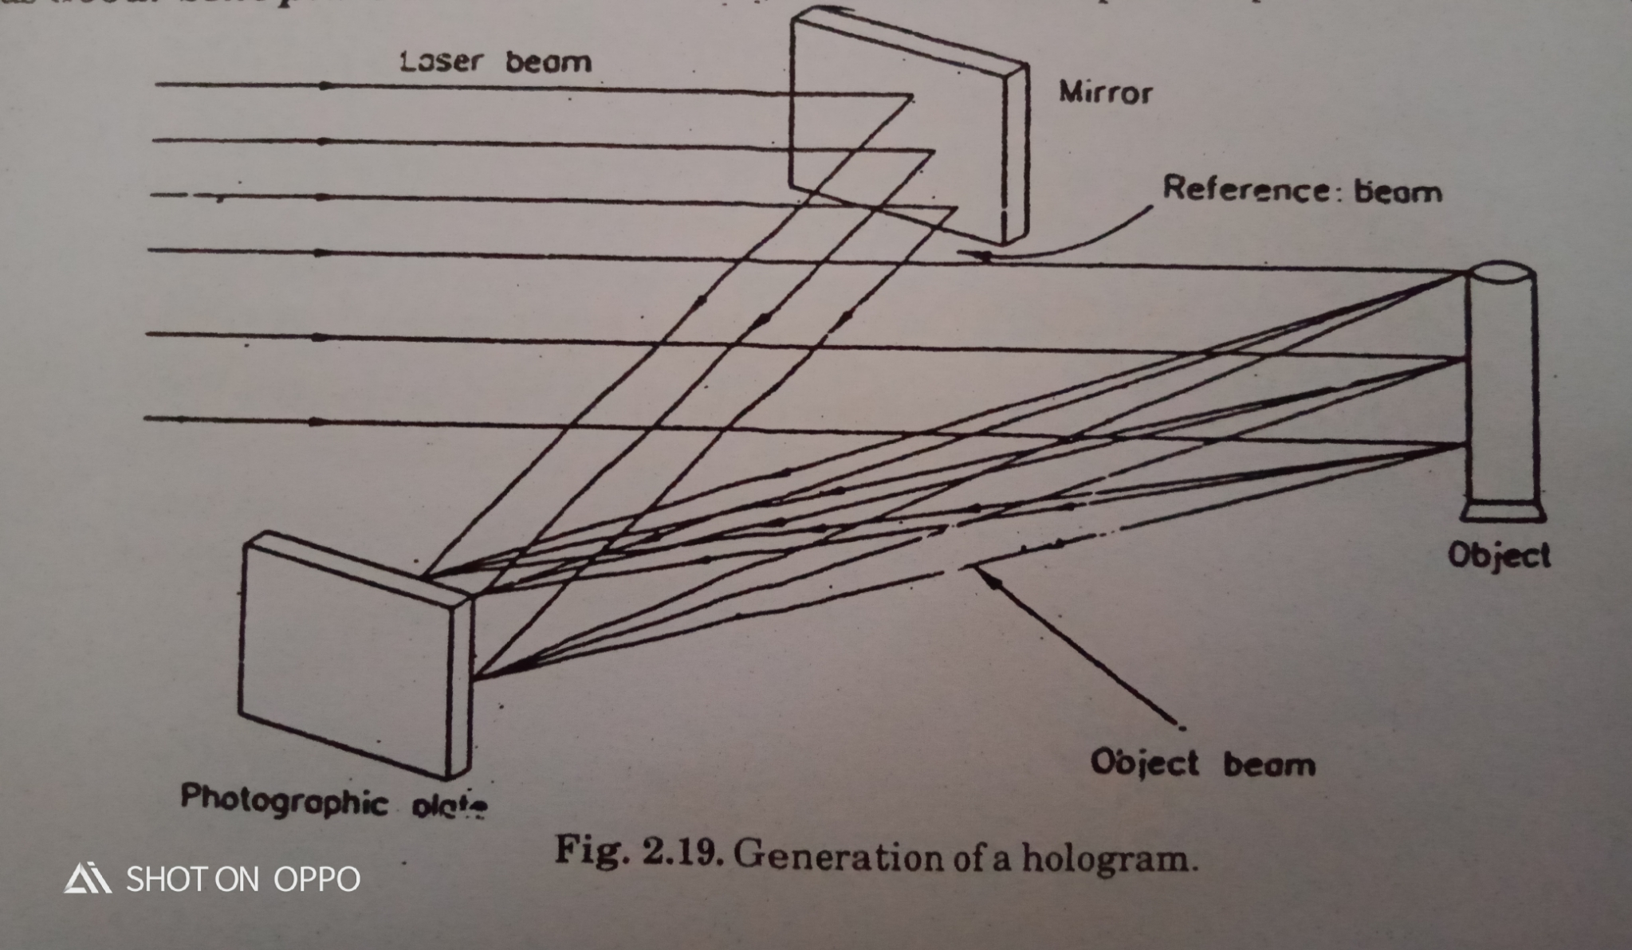
working:-
Gabor recorded the wave pattern on a photographic plate by mixing 2 beams namely a reference beam and an object beam ( the beam reflected by the object) .
The object is illuminated by highly monochromatic and coherent light (laser beam) .

Slide 46
Light is reflected from the to entire photographic plate. A part of the incident laser beam is made to fall on a plane mirror which reflects it toward the photographic plate. This is the reference beam.
The object beam reflected from the object interferes with the reference beam and produces an interference pattern on the photographic plate.
The photographic plate carrying the interference pattern is called a hologram.
This is also known as Gobar Zone Plate.

Slide 47





